Slide 1
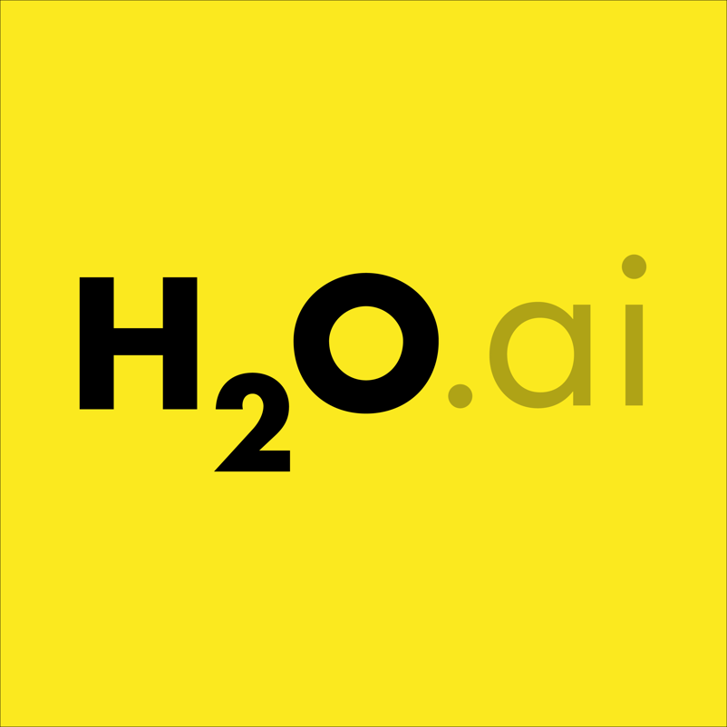
Kaggle Competitions, New Friends, New Skills and New Opportunities
Jo-fai (Joe) Chow
Data Scientist
joe@h2o.ai
@matlabulus
Version 2 – Data Science Exeter Meetup

Slide 2
Civil Engineer → Data Scientist
2005 - 2015
Water Engineer
Consultant for Utilities
SEAMS (Sheffield)
EngD Research
University of Exeter
XP Solutions (Newbury)
2015 - Present
Data Scientist
UK Telecom
Virgin Media
Silicon Valley
Domino Data Lab
H2O.ai
Notes:
s

Slide 3
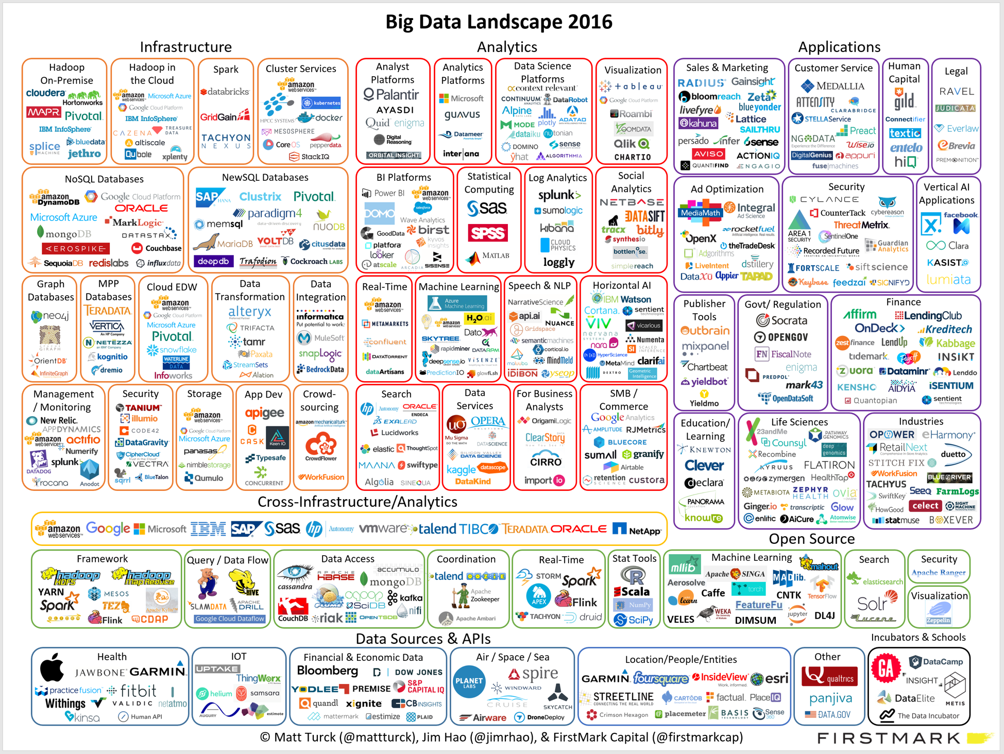
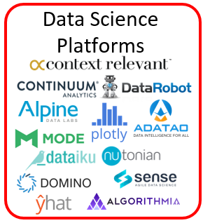
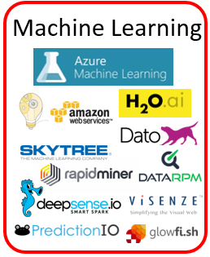
About Domino and H2O

Slide 4
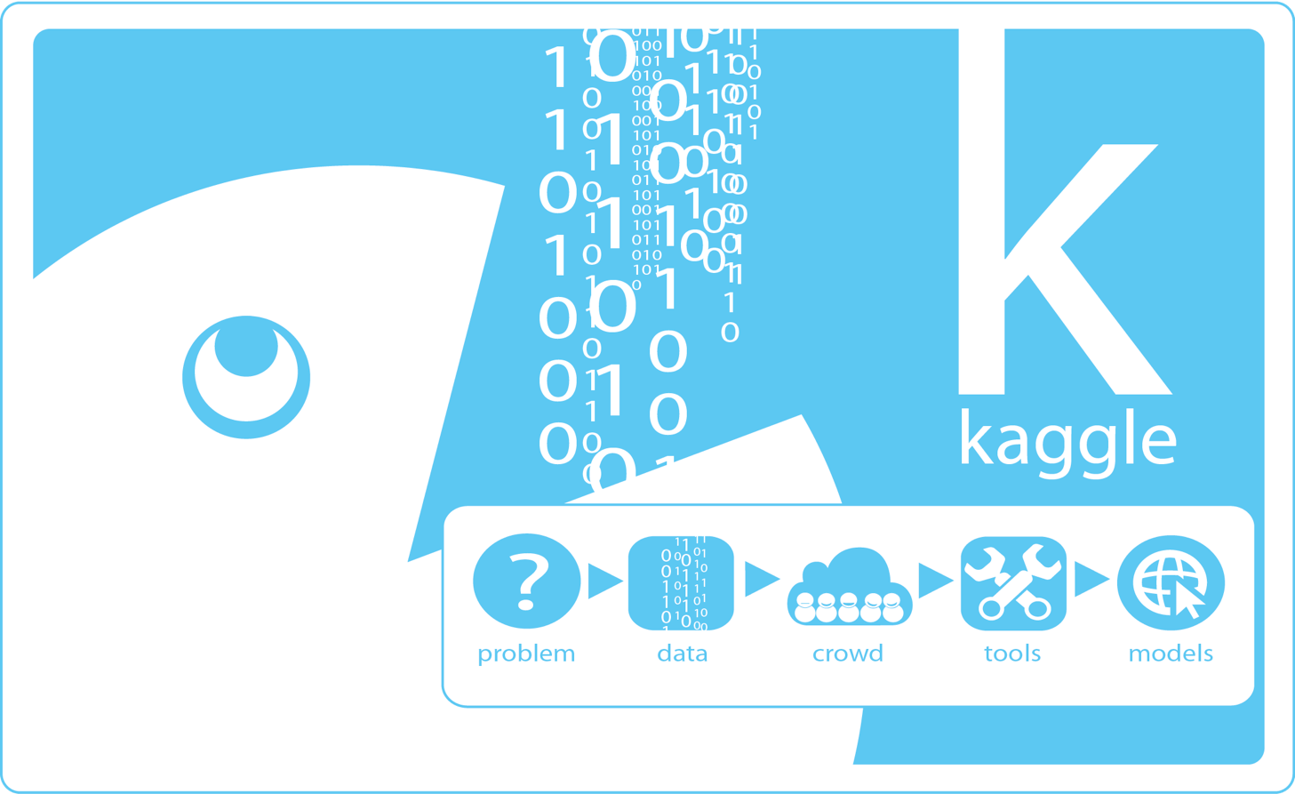
About This Talk
What happened
Things I did since I started participating in Kaggle competitions.
New opportunities – results of new skills and friends.

Slide 5
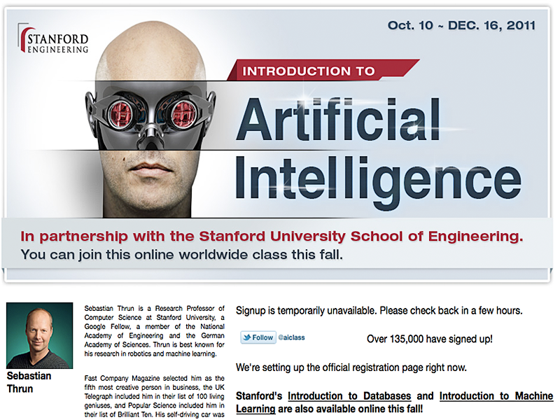
First MOOC Experience
One of the first Massive Open Online Courses.
Met some new friends.
Decided to collaborate for fun.
“How about Kaggle?”
“What is Kaggle?”

Slide 6
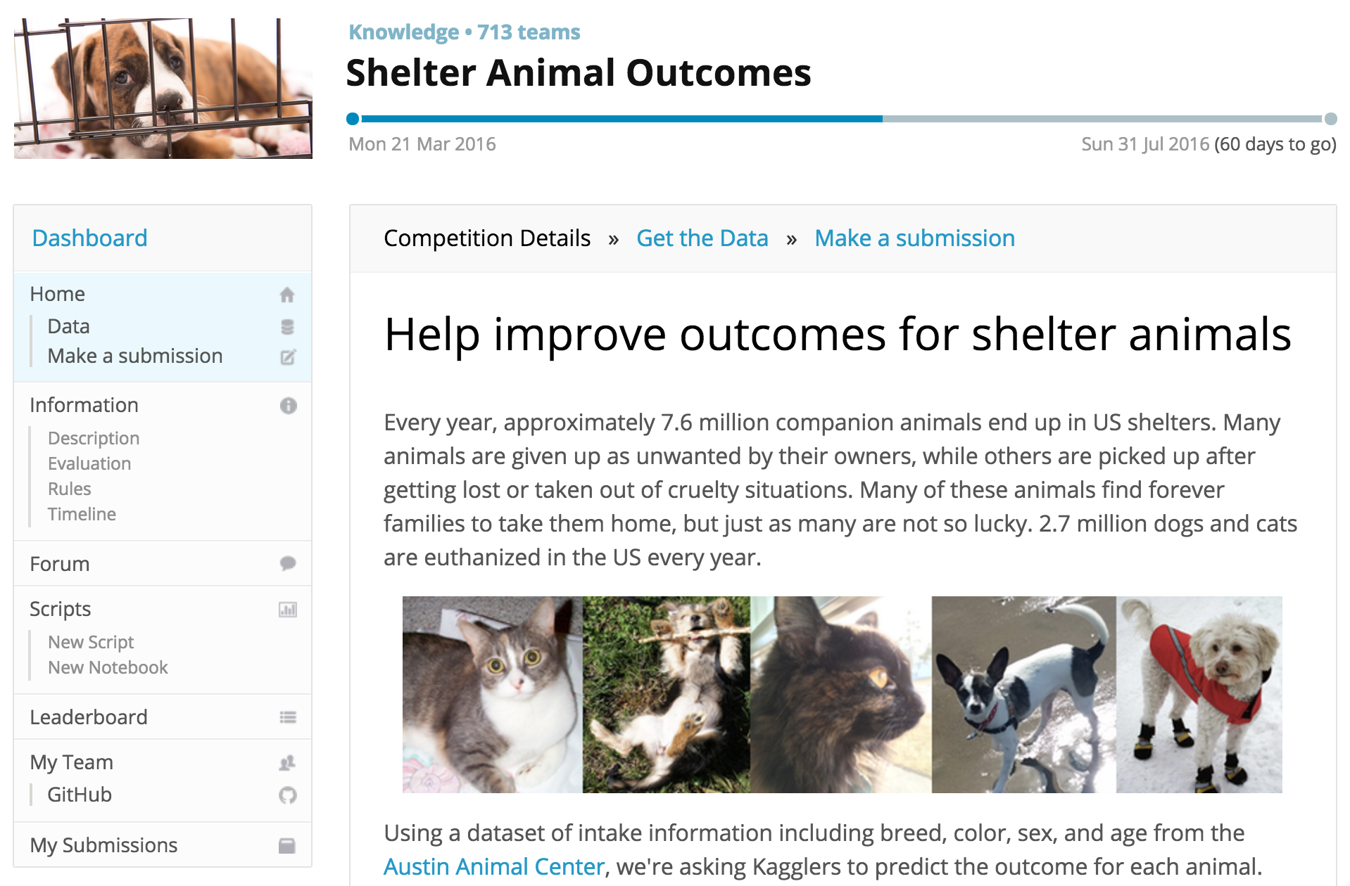
About Kaggle
World’s biggest predictive modelling competition platform
560k members
Competition types:
Featured (prize)
Recruitment
Playground
101
Notes:
All slides and code available online – sit back and relax, remember you’re here today for a good cause, care about shelter animals

Slide 7
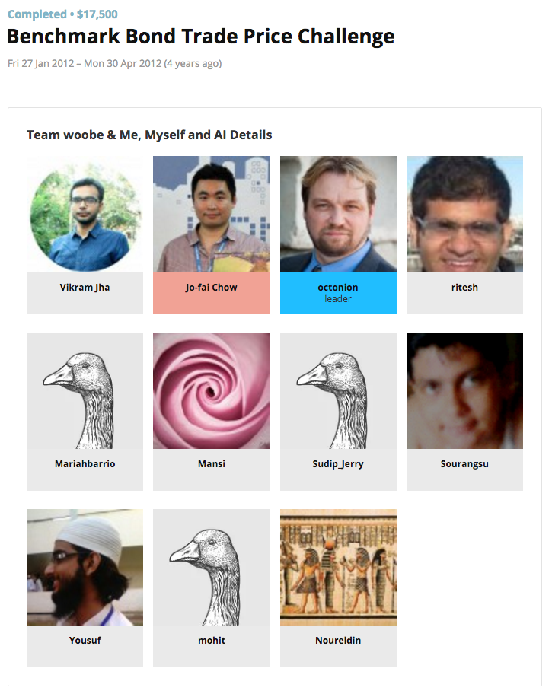
First Kaggle Experience
First time in my life
Supervised learning
Random Forest
Support Vector Machine
Neural Networks
Train, Validate & Predict.
“Is it black magic?”

Slide 8

First Kaggle Experience
Problems
“Hey Joe, you are a nice guy but we can’t work together.”
“You love MATLAB so much. You even call yourself @matlabulous on twitter!”
“We prefer R/Python.”
Results
I kept using MATLAB
Lone wolf
No collaboration ☹

Slide 9
Identifying Skills Gap
Obvious skills gap:
Open-source programming langauges
Machine learning techniques
Collaboration
That competition was a good wake up call.
Kind of related
Data visualisation
Handling large datasets
Explaining results

Slide 10
From MATLAB to R/Python
 | MATLAB | Python | R
Neural Networks | ✔️ | ✔️ | ✔️
Random Forest | ✔️ | ✔️ | ✔️
SVM | ✔️ | ✔️ | ✔️
Other Machine Learning Libraries | Toolboxes (commercial + open source) | Scikit-learn and many more | CRAN, GitHub (A LOT!)
Data Visualisation | I wasn’t good at it anyway … | Matplotlib (plus a lot more since then) | ggplot2 (WOW!) (plus a lot more since then)

Slide 11
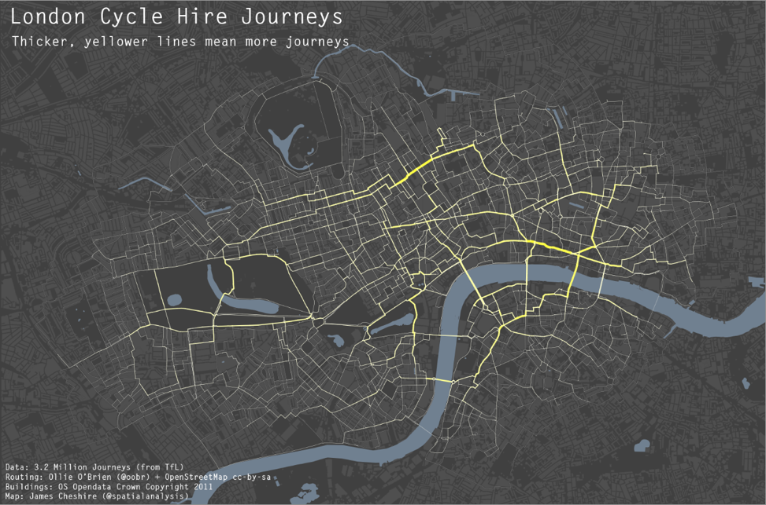
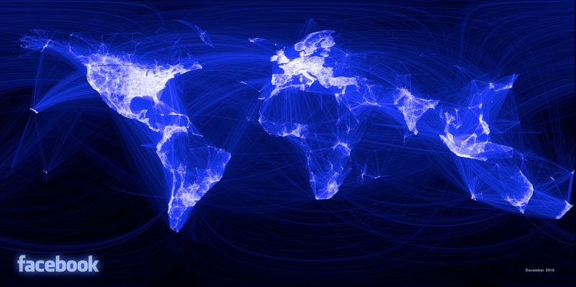
What can people do with R?
James Cheshire, UCL
Link
Paul Butler, Facebook
Link

Slide 12
Filling the Skills Gap
More MOOC
Machine Learning
Andrew Ng (Coursera)
Data Analysis
Jeff Leek (Coursera)
R
Intro to Programming
Dave Evans (Udacity)
Python
Things I also picked up:
Linux (Ubuntu)
Git
Cloud computing
HTML / CSS

Slide 13
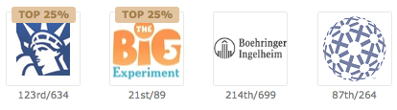
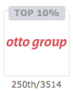
Learning from other Kagglers
Continuous learning
Kaggle’s forums and blogs.
New tools and tricks.
Many things you cannot learn from school.
I am standing on the shoulders of many Kagglers.

Slide 14
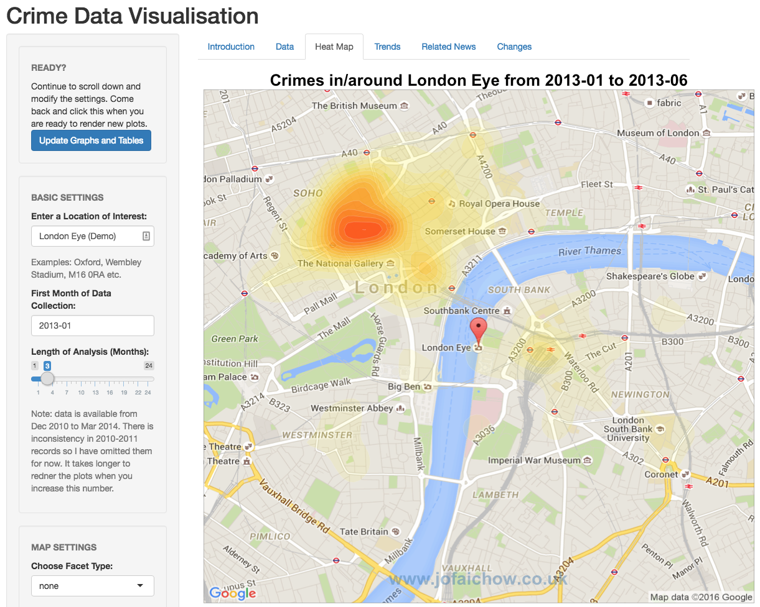
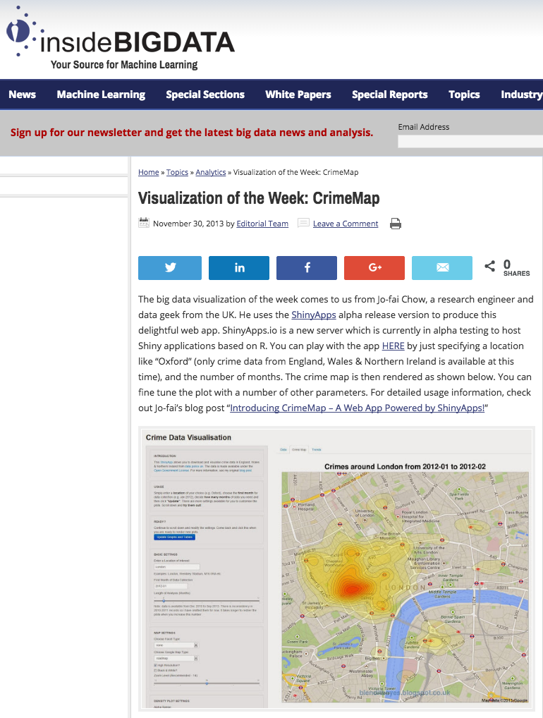
Side Project 1 – Crime Data Viz
Using R + crime data from data.gov.uk
Before I knew it …
shiny::runGitHub("rApps", "woobe",
subdir = "crimemap")
http://insidebigdata.com/2013/11/30/
visualization-week-crimemap/

Slide 15
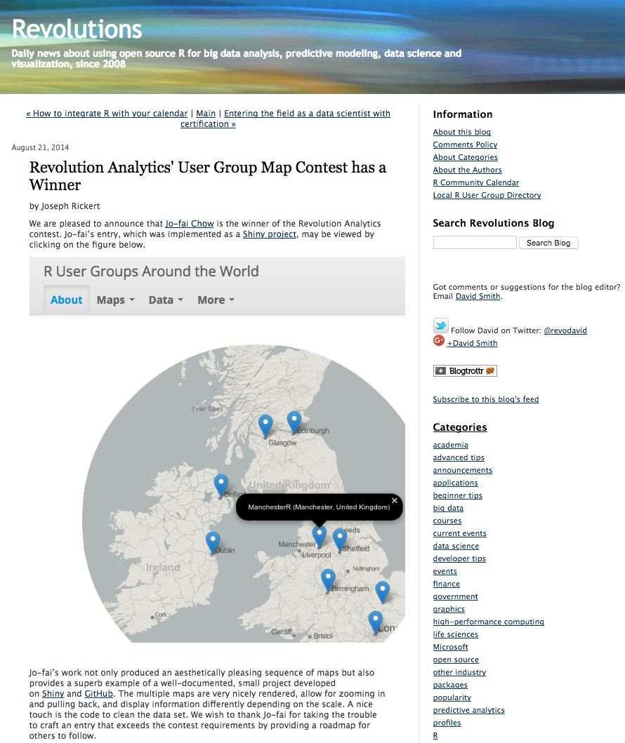
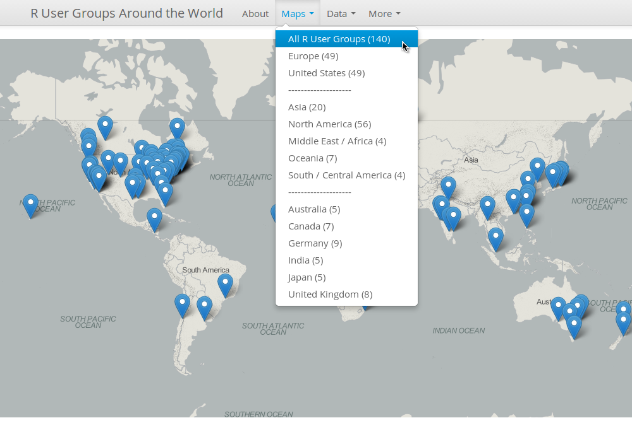
Side Project 2 – Data Viz Contest
While I was obsessed with making maps …
https://github.com/woobe/rugsmaps
http://blog.revolutionanalytics.com/2014/08/
winner-for-revolution-analytics-user-group-map-contest.html

Slide 16
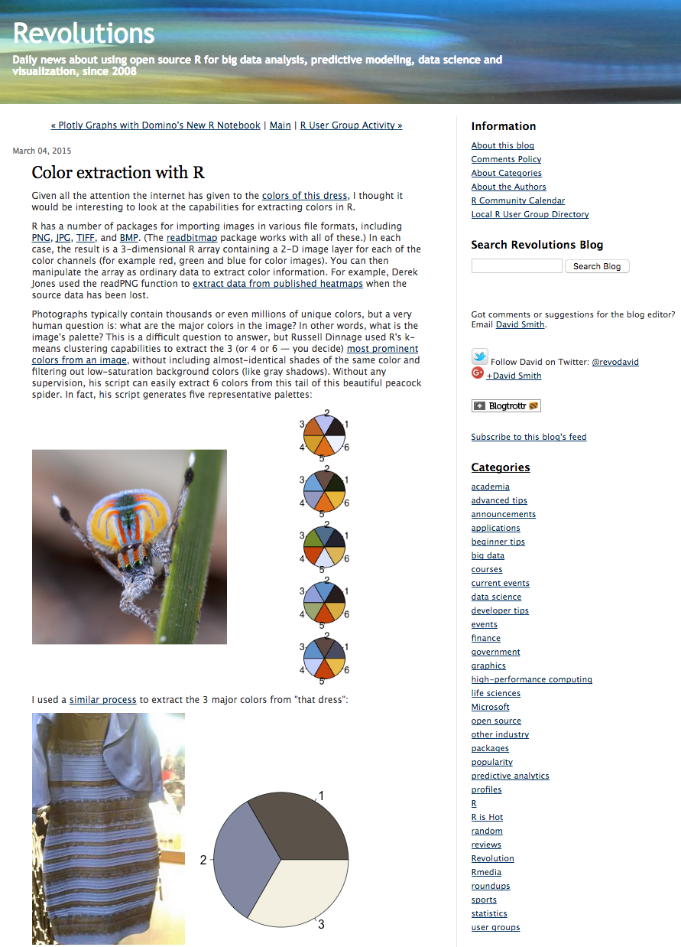
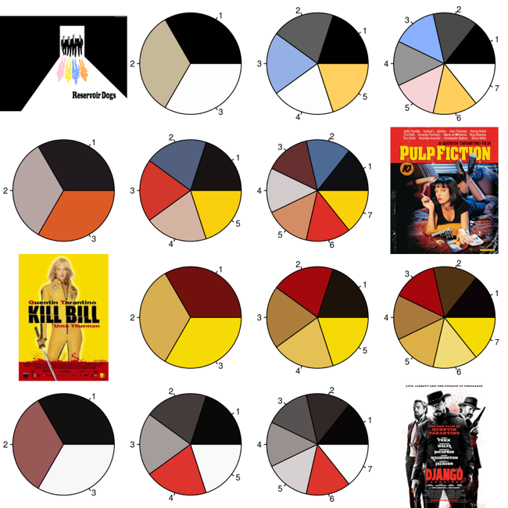
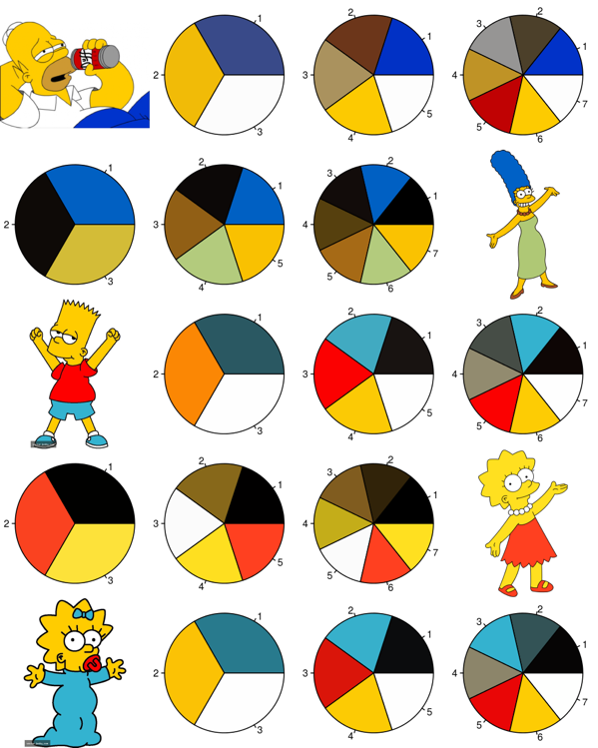
Side Project 3 – Colour Palette
I am also obsessed with colours …
#TheDress
https://github.com/woobe/rPlotter
http://blog.revolutionanalytics.com/
2015/03/color-extraction-with-r.html

Slide 17
Side Project 4 – World Cup 2014
World Cup 2014 Correct Score Prediction
ML vs. my friends
10 out of 64 (15.6%)
Friends’ avg. = 4 (6.3%)
github.com/ woobe/wc2014
Euro 2016
Collecting data right now
github.com/woobe/ euro2016

Slide 18
Open Up Myself
Before Kaggle/MOOC
I was drawing a circle around myself.
Fear of change.
Domain-specific problem solving.
After Kaggle/MOOC
Data-driven approach.
Not a subject matter expert? No worries ☺
Free to try new tools, to learn and to create.

Slide 19
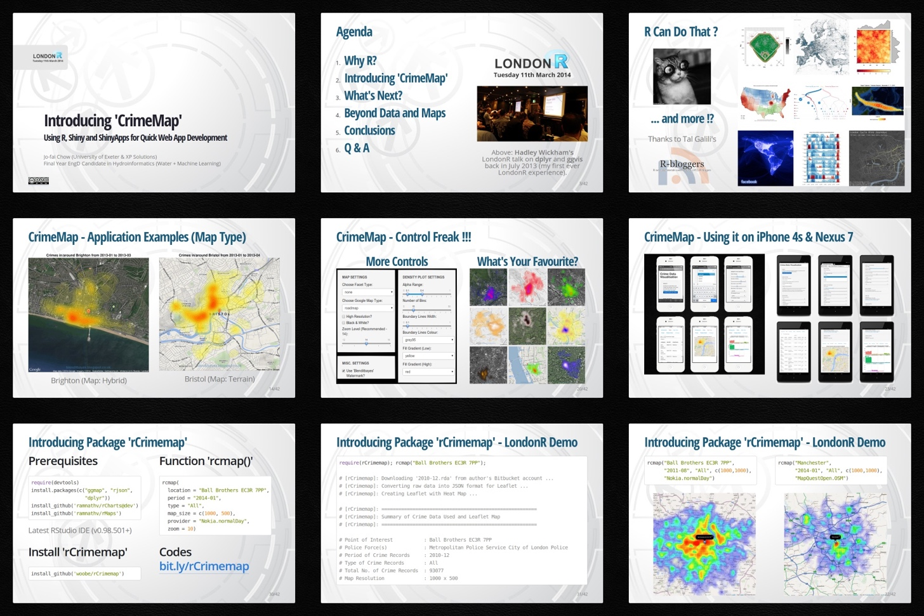
New Opportunities
LondonR
First presentation outside water industry / academia.
Very positive feedback.
Led to other projects.
bit.ly /londonr_crimemap

Slide 20
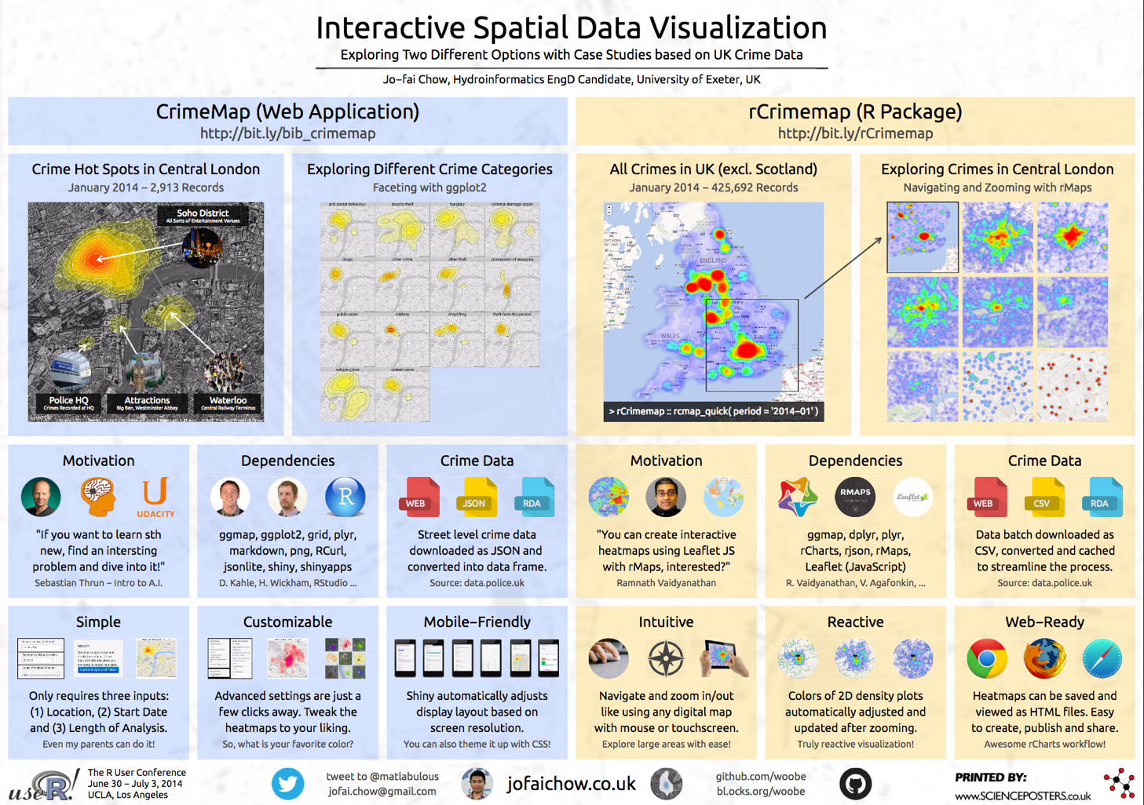
New Opportunities
useR! 2014 (UCLA)
Presented a poster.
Met new friends.
Life-changing event.
github.com/ woobe/useR_2014

Slide 21
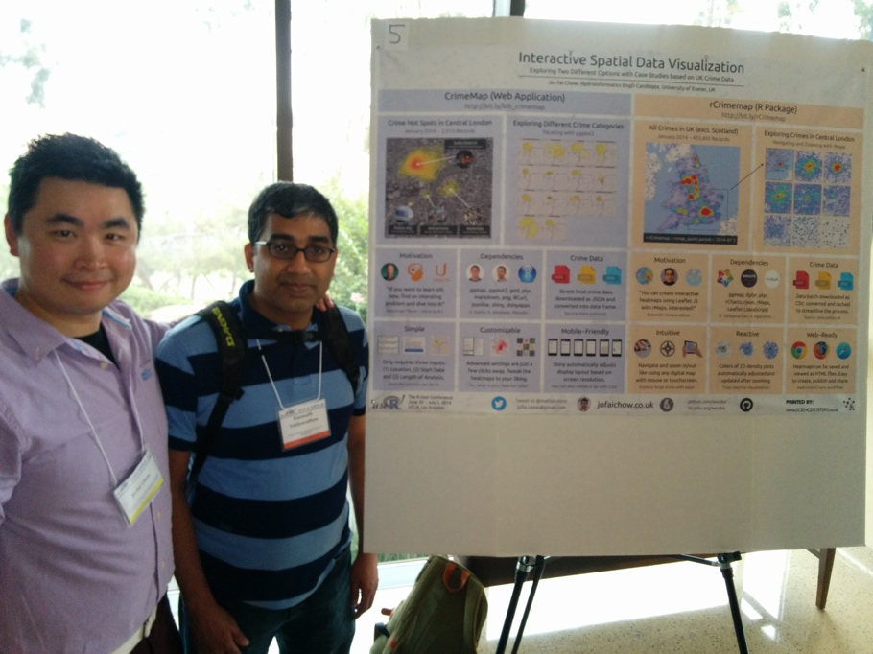
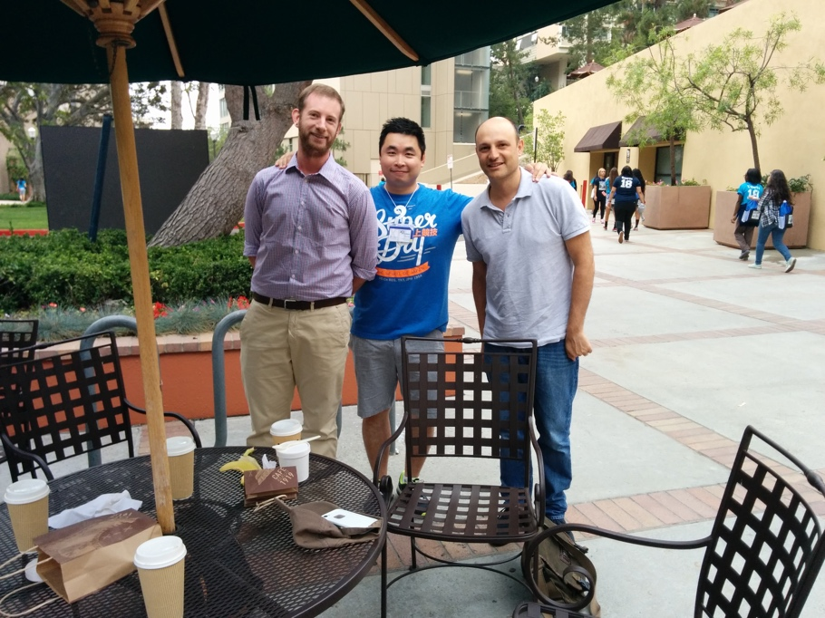
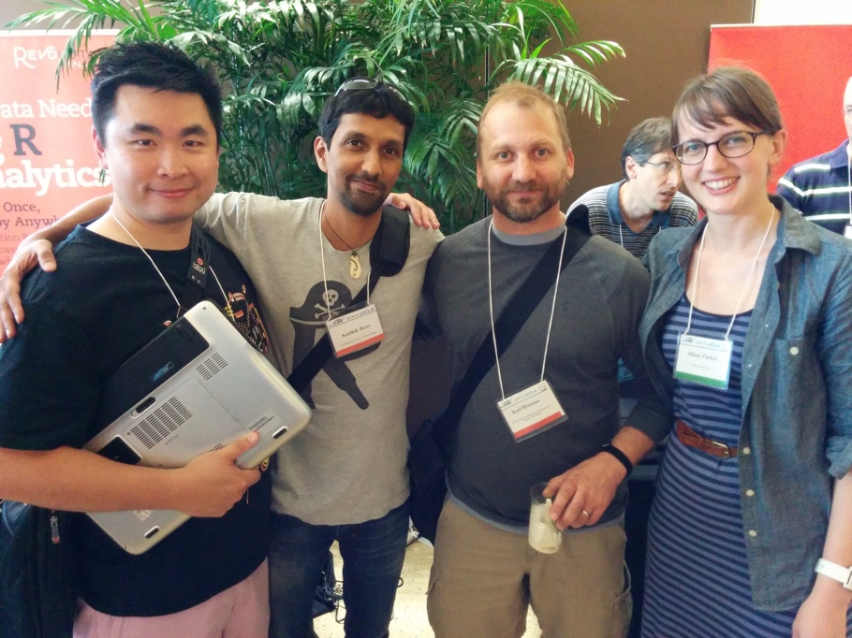
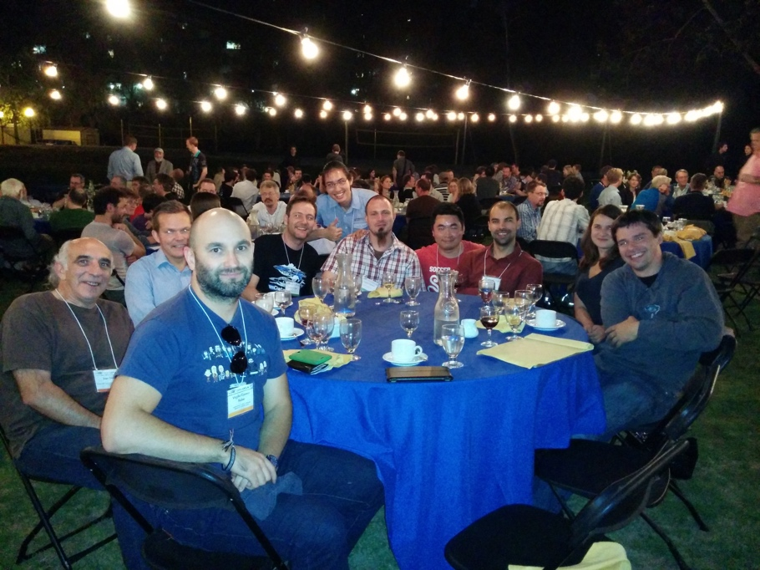
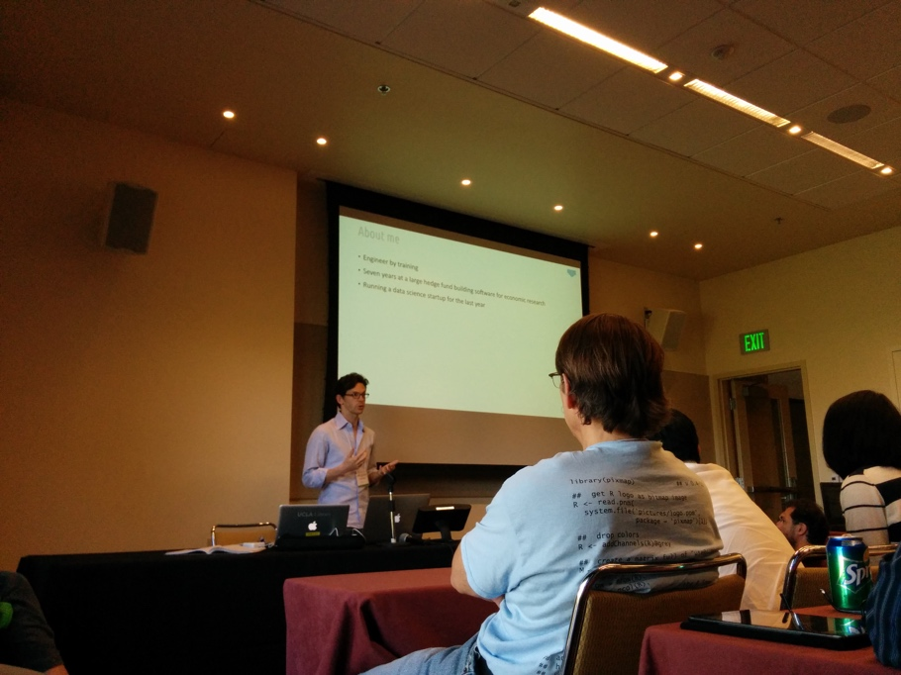
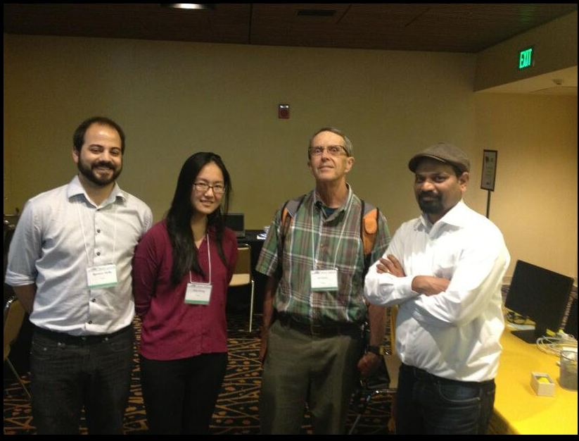
New Friends
Ramnath Vaidyanathan
htmlwidgets
RStudio
rOpenSci
Matt Dowle
data.table (also at H2O.ai)
Nick @ DominoDataLab
H2O.ai &
John Chambers!
DataRobot

Slide 22
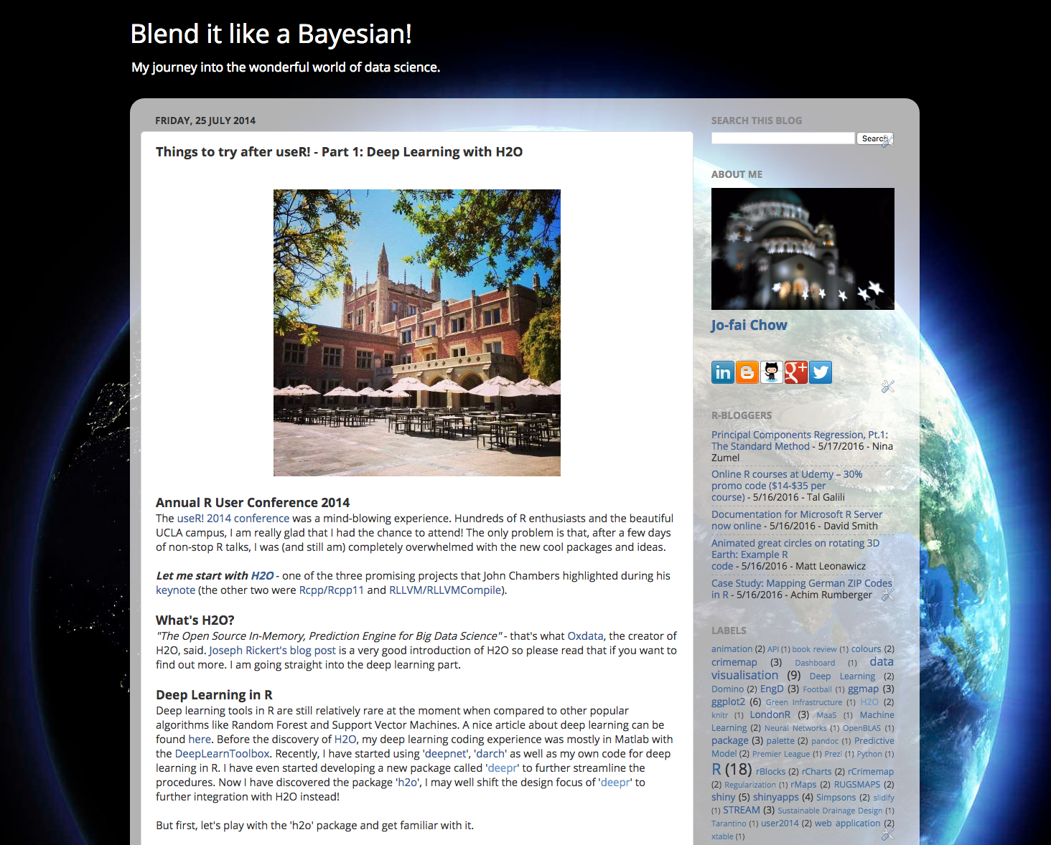
More Opportunities
First blog post about H2O
Things to try after useR! – Part1: Deep Learning with H2O

Slide 23
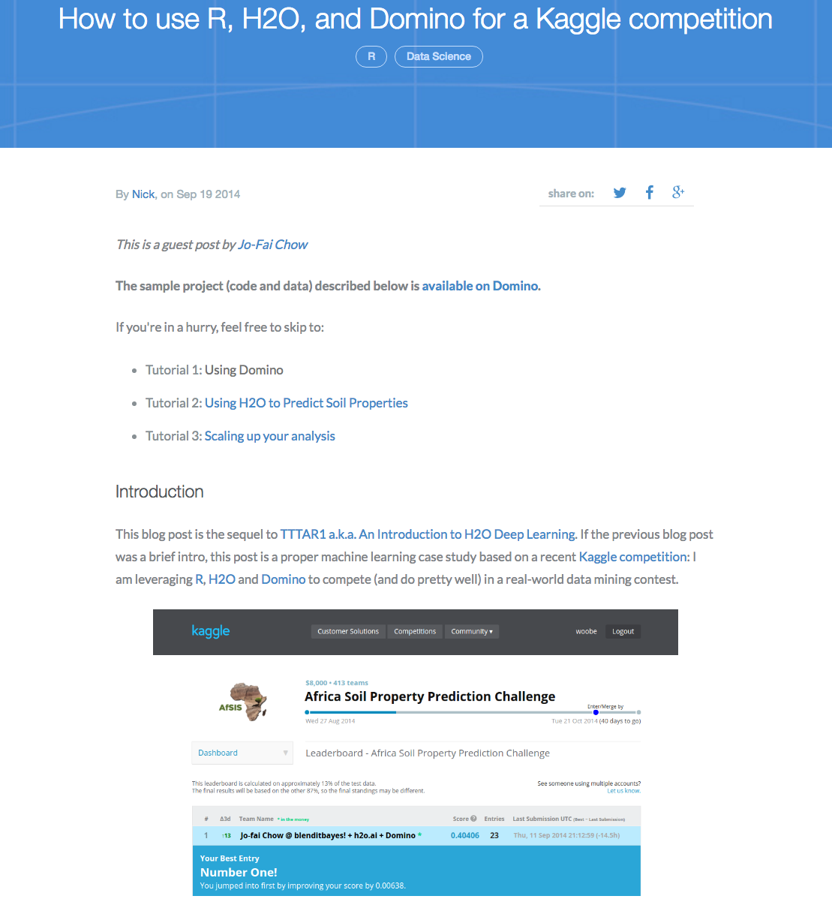
More Opportunities
Blog post about Domino and H2O
I did it for fun. I did not have any expectation.
It helped attract customers to both Domino and H2O.

Slide 24
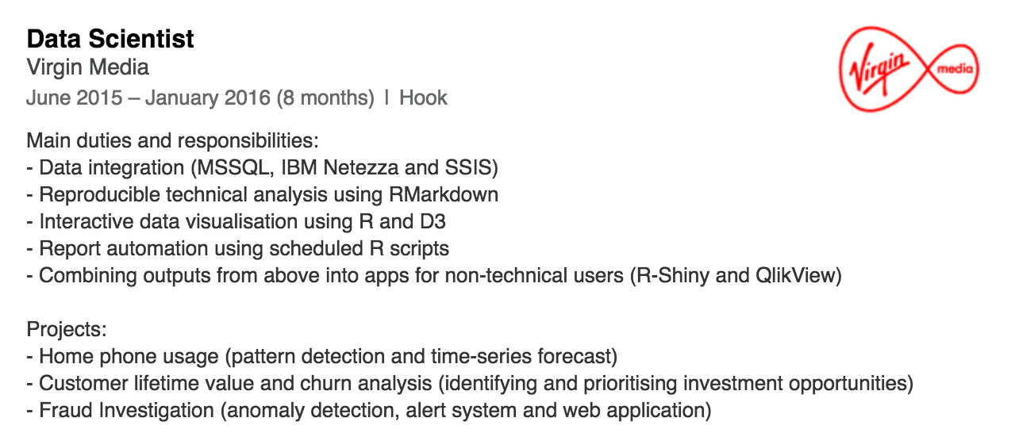
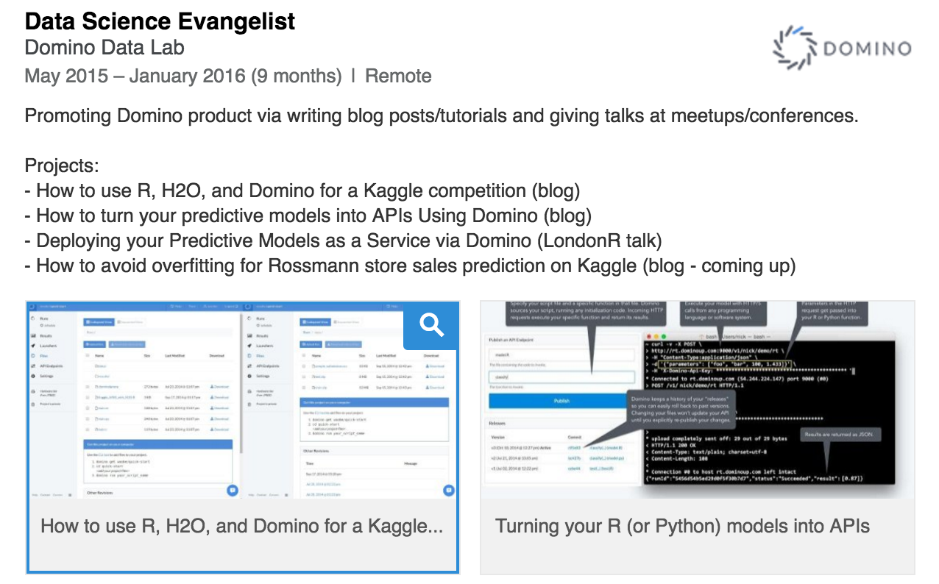
Becoming a Data Scientist
The leap of faith …

Slide 25

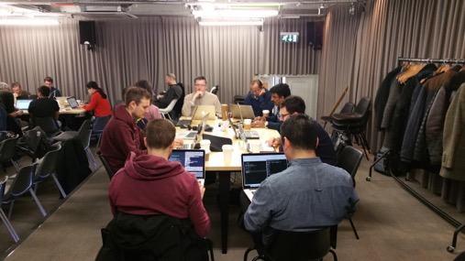
London Kagglers Assemble
London Kaggle Meetup
Sep 2015
I met my Kaggle buddy Mickael Le Gal
He is a product data scientist at Tictrac
Mickael
Joe

Slide 26
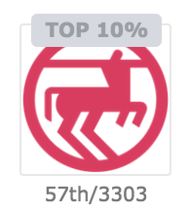
London Kagglers Assemble
Rossmann Store Sales
We got stuck at top 10% for a long period.
Mickael had a breakthrough in feature engineering with 48 hours to go.
I re-trained all models and completed model stacking just a few hours before the deadline (thanks to Domino Data Lab).
Top 2% finish (our best result so far).

Slide 27
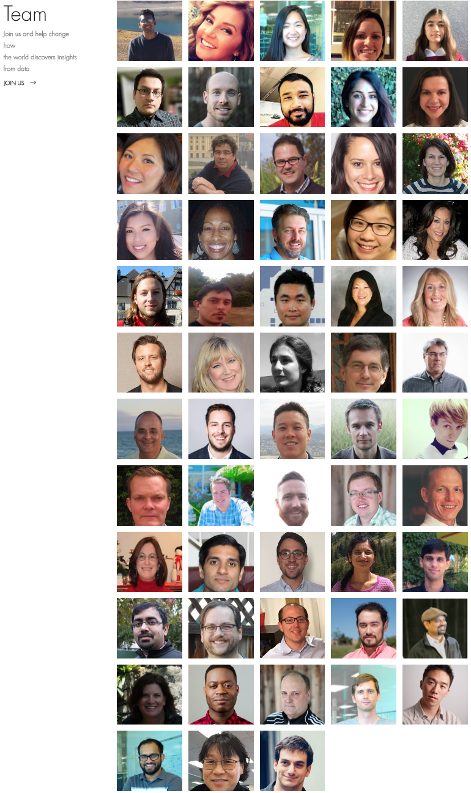
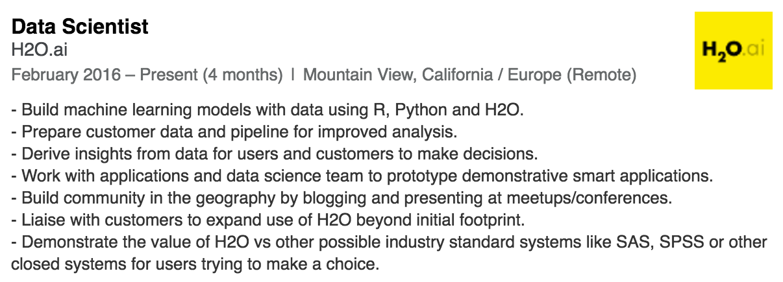
Joining H2O.ai
A call from Sri (CEO) just before Christmas 2015 …

Slide 28
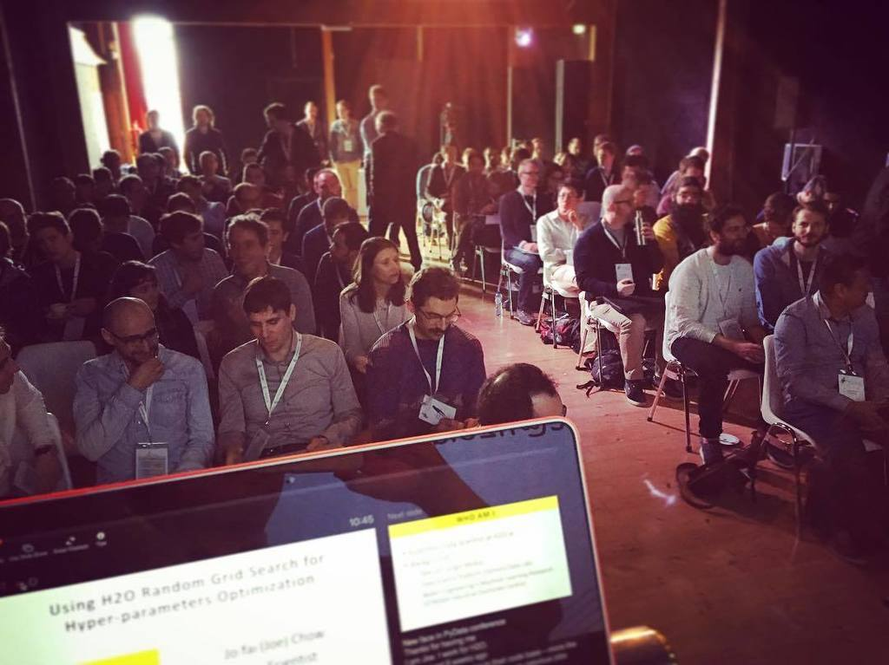
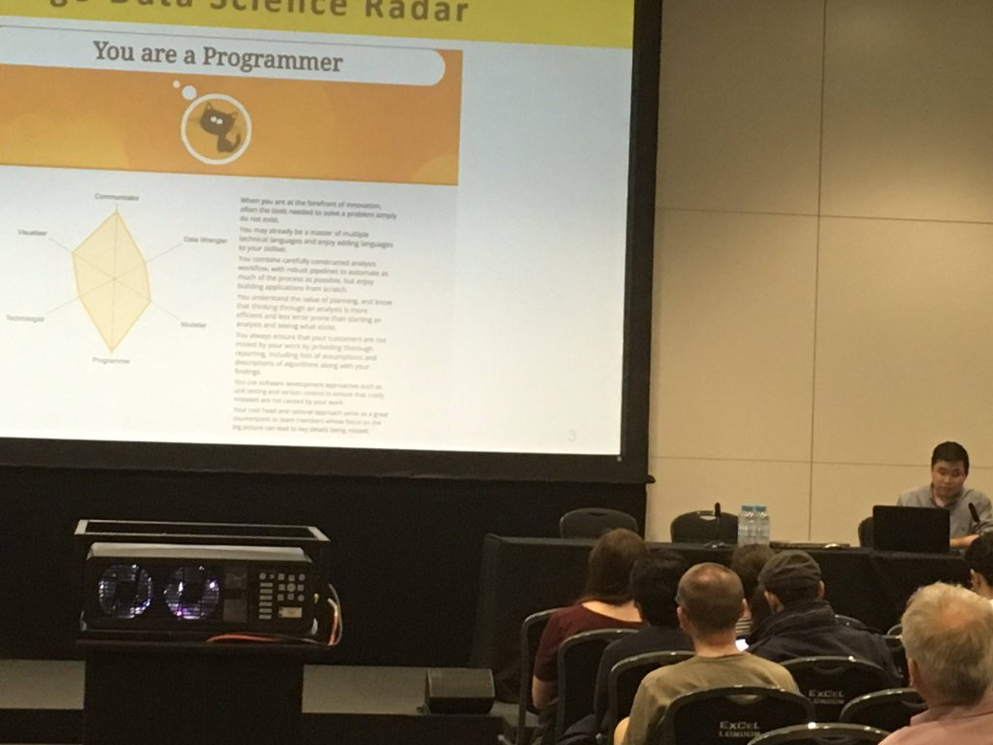
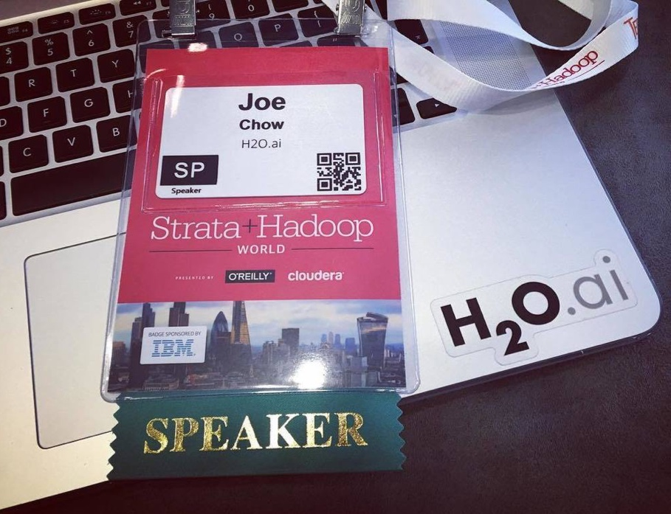
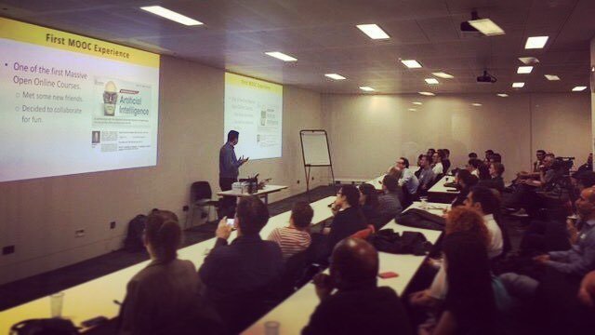
More Opportunities
PyData Amsterdam
LondonR
bit.ly/joe_h2o_talk1
bit.ly/joe_h2o_talk2
bit.ly/joe_h2o_talk3
bit.ly/joe_h2o_talk4
…
London Kaggle

Slide 29
Summary of Benefits
Direct
Identify data science skills gap.
Learn quickly from the community.
Expand your network.
Prepare yourself for real-life data challenges.
Indirect
You also learn non-ML skills along the way.
You learn to build small data products (e.g. graph, web app, REST API) and help others gain insight.

Slide 30
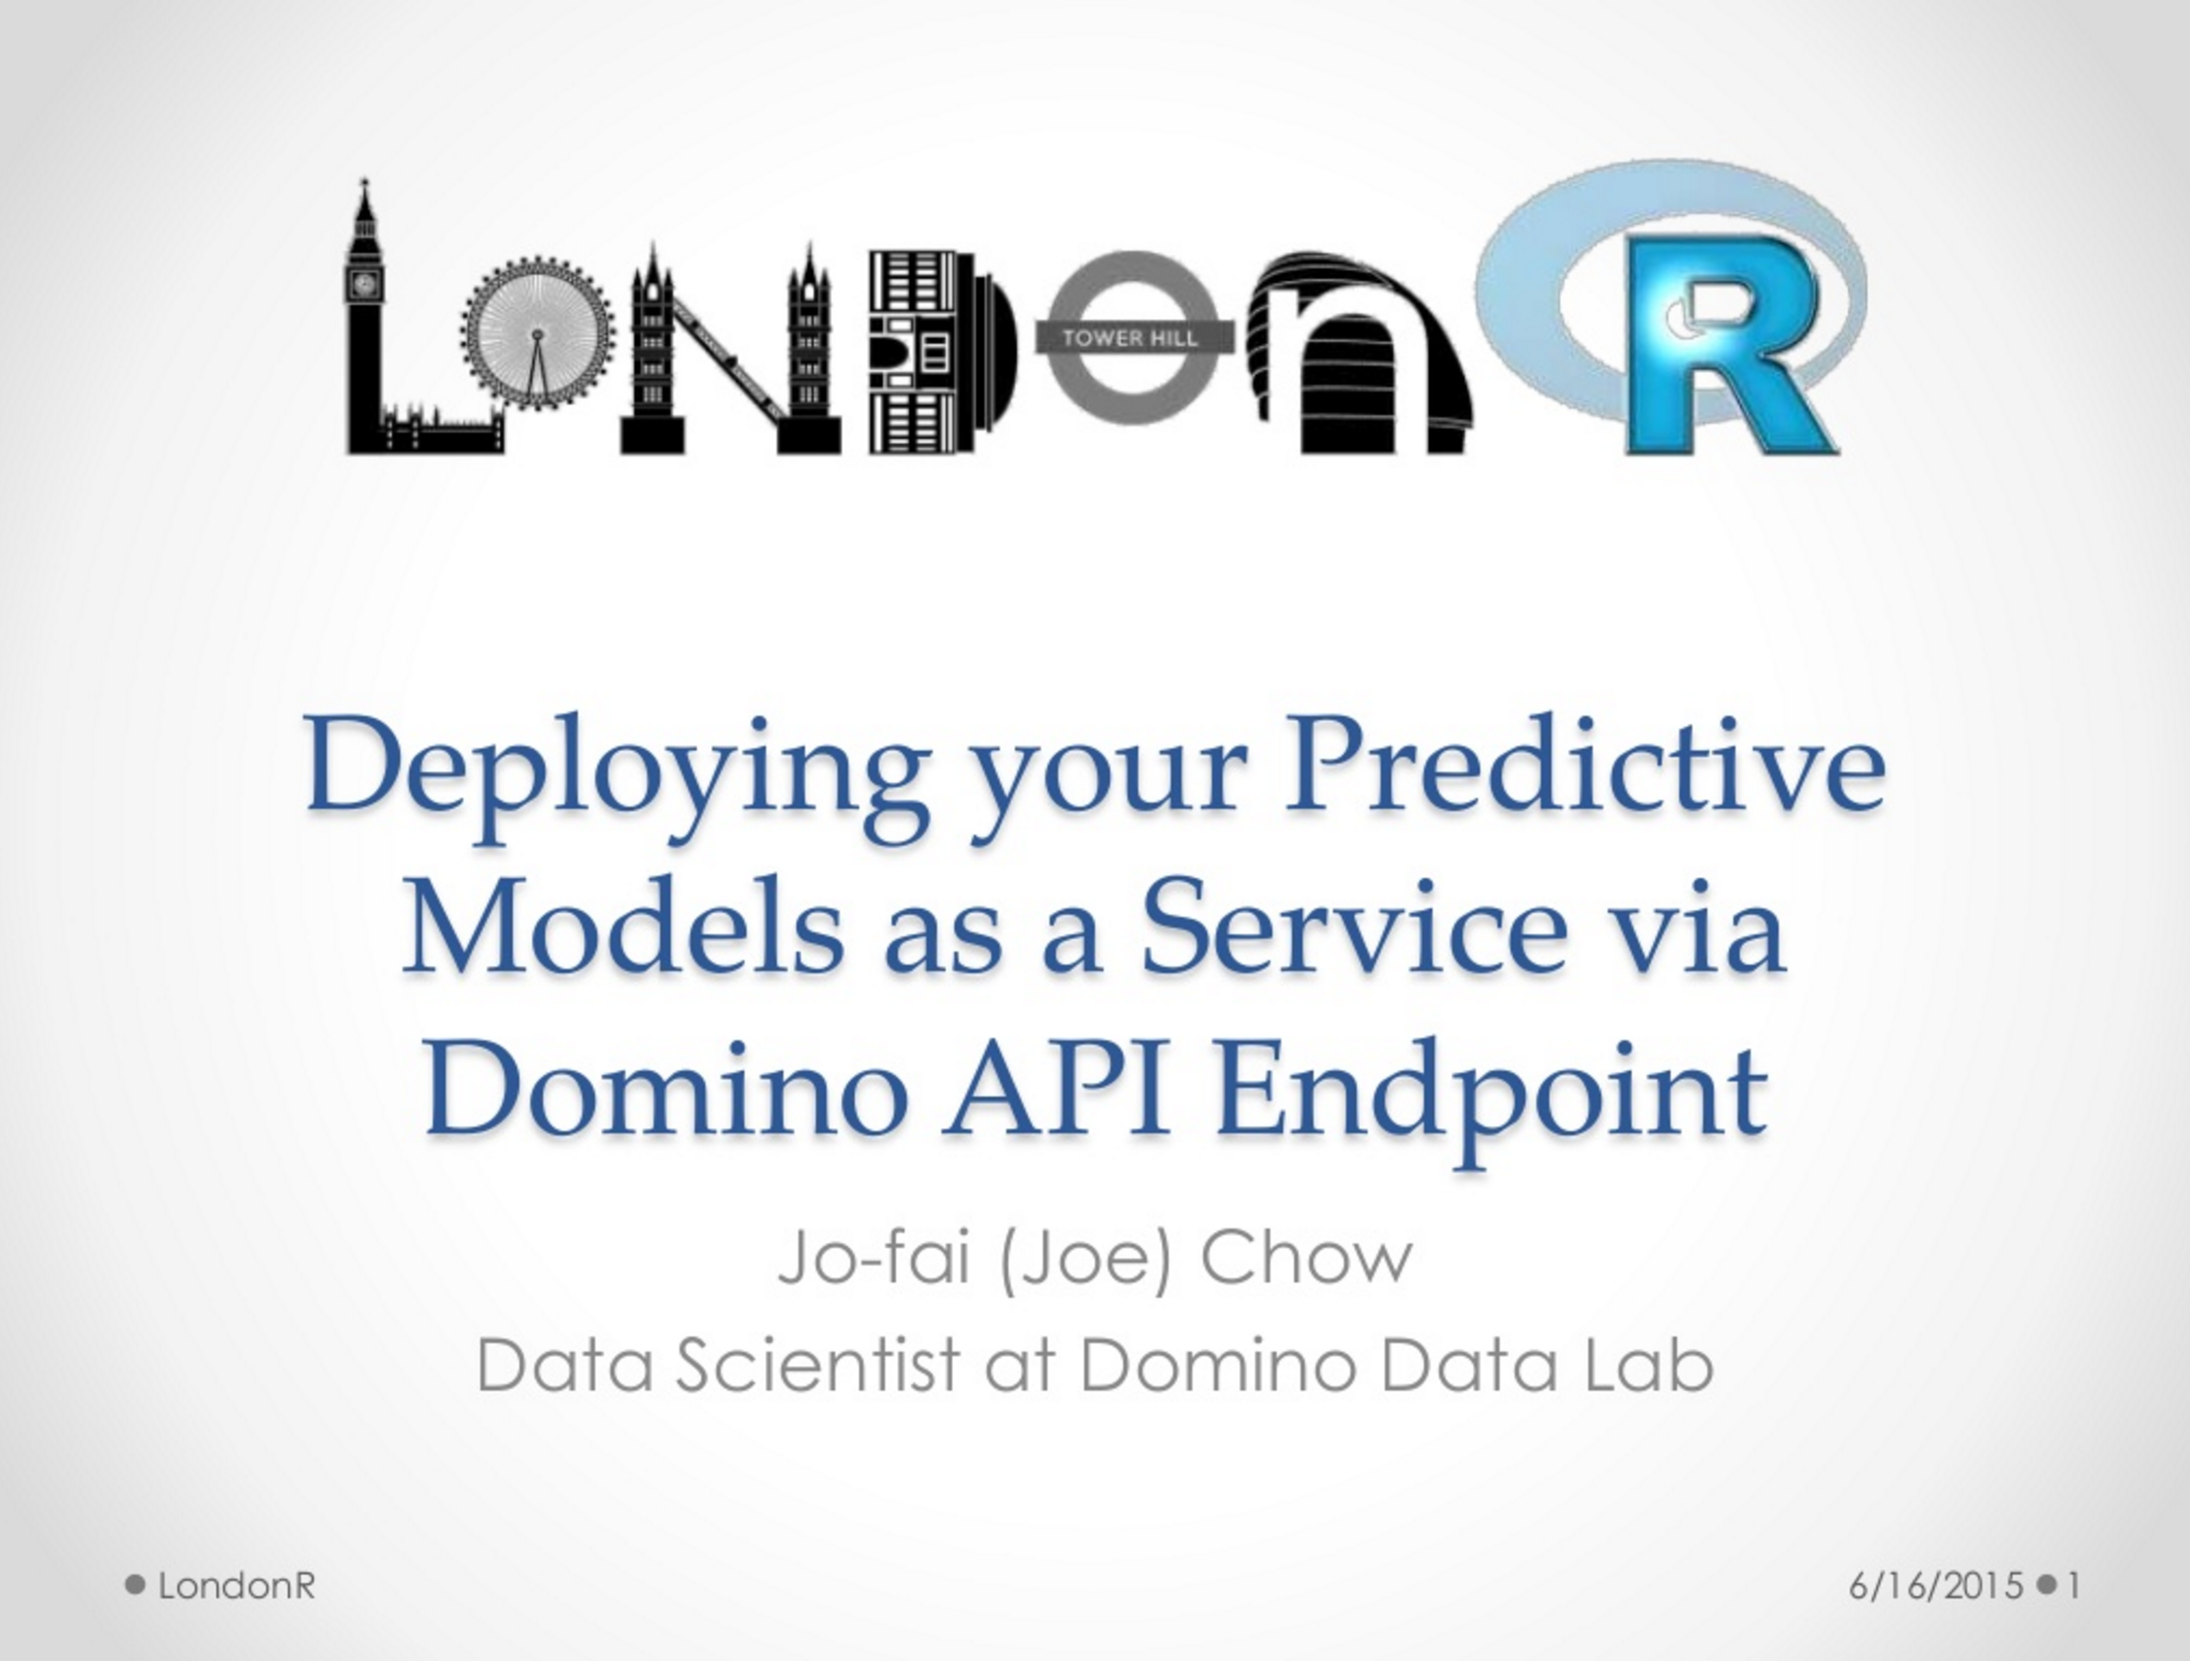
Big Thank You!
University of Exeter
Prof. Dragan Savic
Mango Solutions
RStudio
Domino Data Lab
H2O.ai
London Kaggle Meetup Organisers
1st LondonR Talk
Crime Map Shiny App
bit.ly/londonr_crimemap
2nd LondonR Talk
Domino API Endpoint
bit.ly/1cYbZbF

Slide 31
Any Questions?
Contact
joe@h2o.ai
@matlabulous
github.com/woobe
Links (All Slides)
github.com/h2oai/h2o-meetups
H2O in London
Coming soon!
Meetups
Office
We’re hiring!
www.h2o.ai/careers

